Slide 1
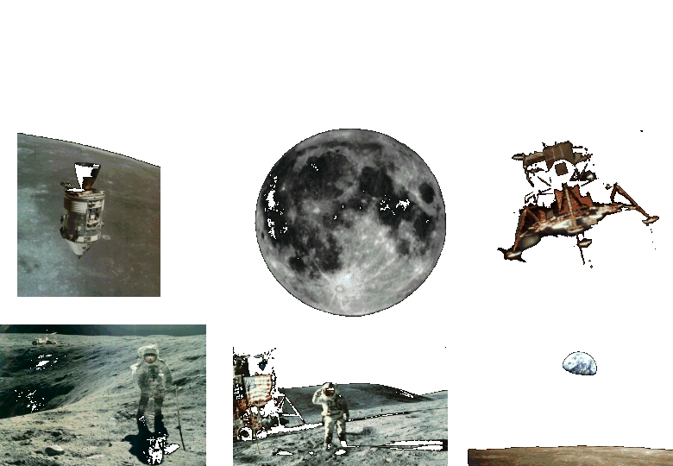
Apollo to the Moon

Slide 2
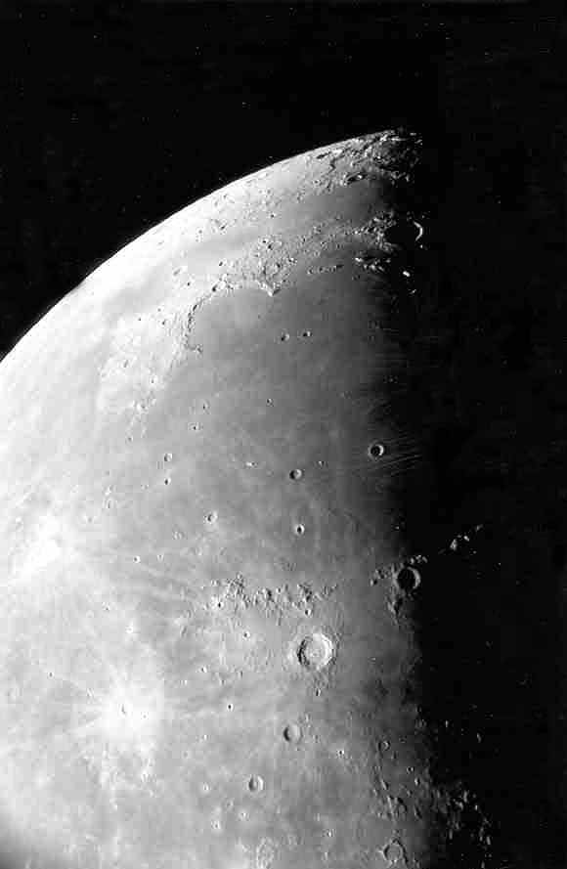
Moon maria as seen through the telescope.
Photo by Jim Fullerton

Slide 3
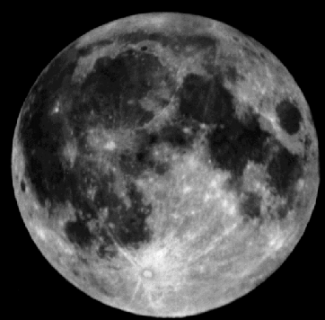
The maria (mare) are the smooth dark areas on the surface of the Moon.
Mare
Highlands

Slide 4
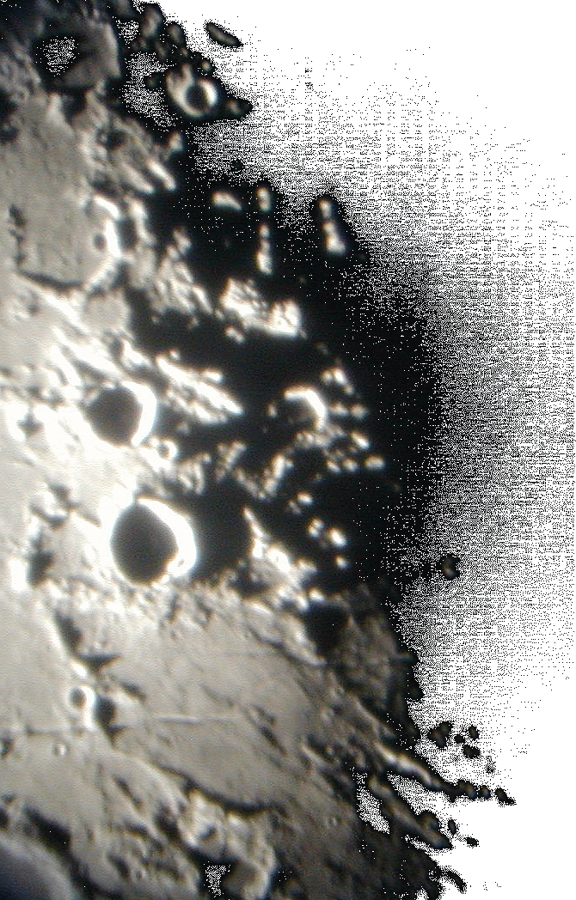
The Moon=s many craters and other features are best seen near the terminator - the line between day and night.
Photo by Lake Afton Public Observatory

Slide 5
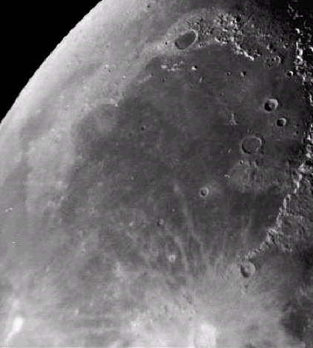
This photo shows a smooth floored lunar mare. You can easily see the ancient rim of the original impact basin.
Mare Imbrium

Slide 6
The maria were formed about 3.5 – 4 billion years ago.
Lava flowed through cracks in the lunar surface and filled in low laying areas.
Mare Imbrium

Slide 7
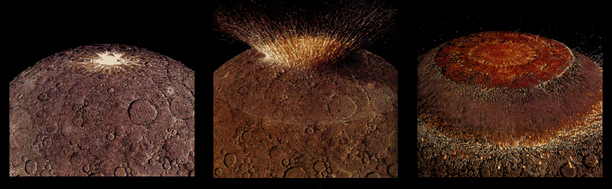
Four billion years ago the impact from a large asteroid formed a huge multi-ringed basin which then thinned and fractured the lunar crust.

Slide 8
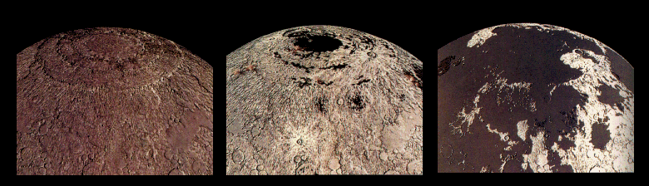
Fluid lavas from beneath the moon’s crust flowed out and flooded the low regions of the lunar surface – covering up many craters.

Slide 9
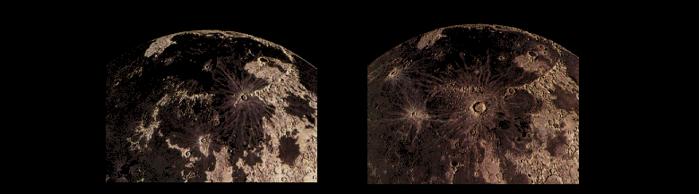
Less than a billion years after they began, the lavas ceased flowing out onto the Moons surface. However, occasionally new craters were created on top of these ancient flows.

Slide 10
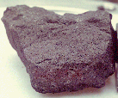
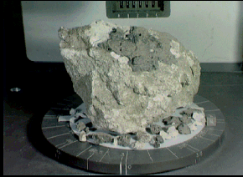
Lunar rock samples from the moon’s maria are dark colored rocks.
Samples from the highland regions are much lighter in color.

Slide 11
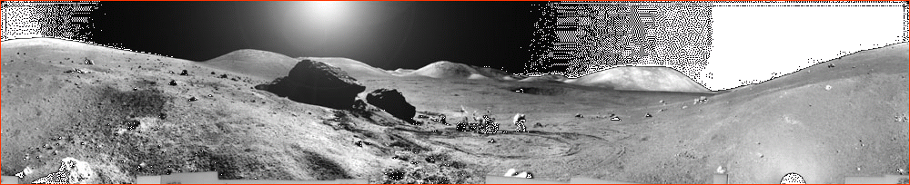
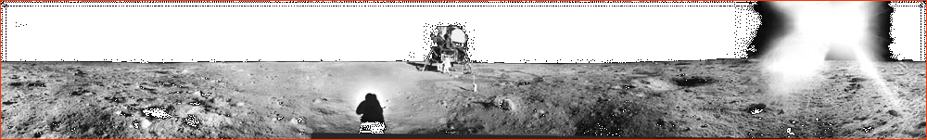
One of these shows the lunar surface from a mare and the other the highlands.
Can you tell which is which?

Slide 12
The highlands are rugged.
The mare are smooth & flat.

Slide 13
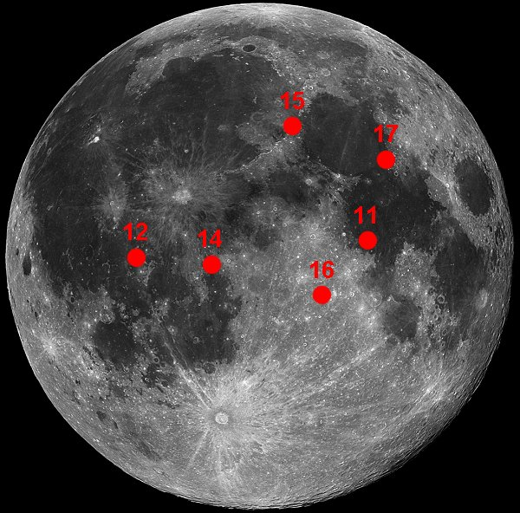
Apollo 14 Landing Site

Slide 14

Apollo 14 –
Shepard, Mitchell, & Rossa
The primary objective was to land at a more challenging site in an area of high scientific interest in the highlands.

Slide 15
Apollo 14 –
Shepard, Mitchell, & Rossa
The secondary objectives were to deploy the second Apollo Lunar Surface Experiments Package (ALSEP) and use a pull cart dubbed Shepard’s Rickshaw to haul equipment and samples.

Slide 16
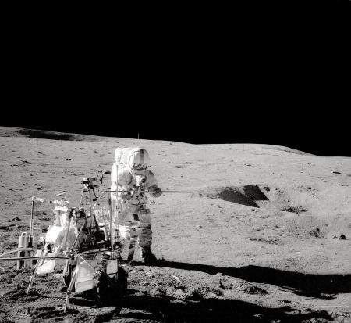
Apollo 14
The hilly terrain and regolith proved to be a serious challenge. It made footing difficult and pulling Shepherd’s Rickshaw nearly impossible.
Shepherd’s Rickshaw

Slide 17
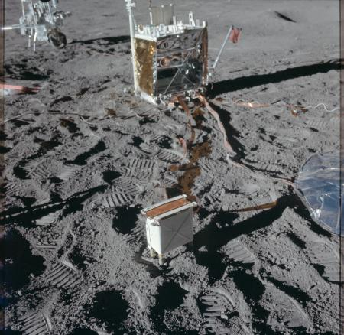
Apollo 14
Shepard’s Rickshaw
The ALSEP (Apollo Lunar Surface Experiments Package.

Slide 18
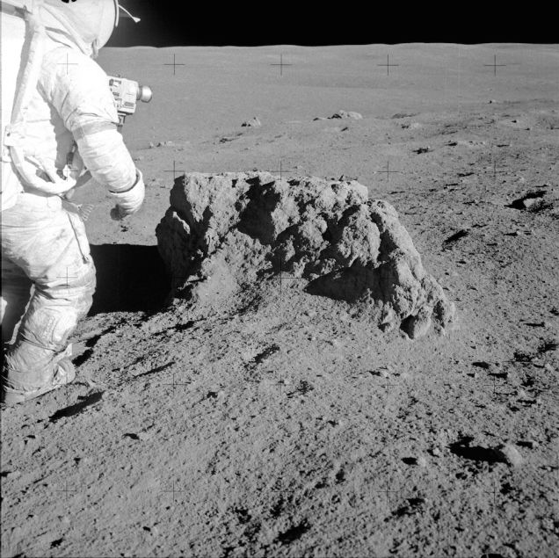
Apollo 14
Some of the material returned was 3.85 billion years old - most likely material ejected during the formation of the crater which now contains Mare Imbrium

Slide 19
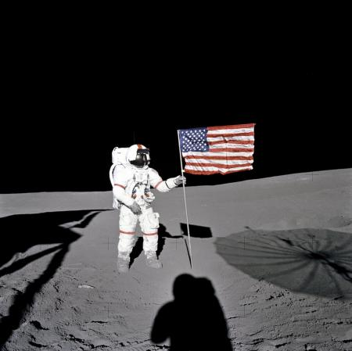
Apollo 14
The importance of some sort of Lunar G P S (LGPS) was made clear during this mission - a crew member could easily get lost in his own “back yard”

